Slide 1



DA07

Slide 2









PROBLEM STATEMENT
Addressing Social Determinants of Health (SDOH) presents challenges in capturing individual social circumstances effectively. Current approaches lack feasibility, patient reluctance, and actionable guidance, necessitating a proactive model. Objectives of the Community Companion Challenge include creating a Social Care Scorecard, connecting individuals with resources, and considering India's healthcare context to reduce disparities and empower patients.

Slide 3


EXPLORATORY DATA ANALYSIS

Slide 5
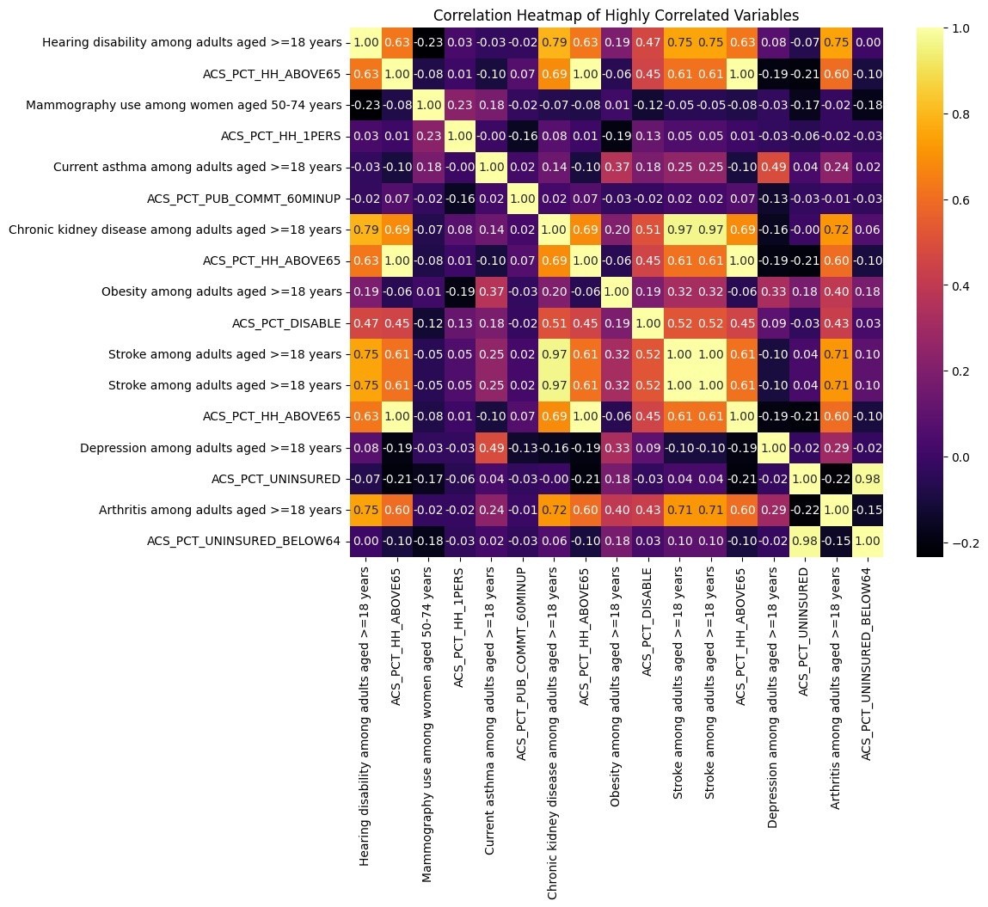
OBJECTIVE 1
EXPLORATORY DATA ANALYSIS
CORRELATION HEATMAP:
From the heatmap, we can observe the pairwise correlations between the selected variables. Positive correlations are indicated by warmer colors, while negative correlations are shown by cooler colors. Strong correlations (close to 1 or -1) suggest a strong linear relationship between the variables, while weaker correlations indicate less association. This visualization helps identify patterns of association and potential multicollinearity among the variables in the dataset.

Slide 6
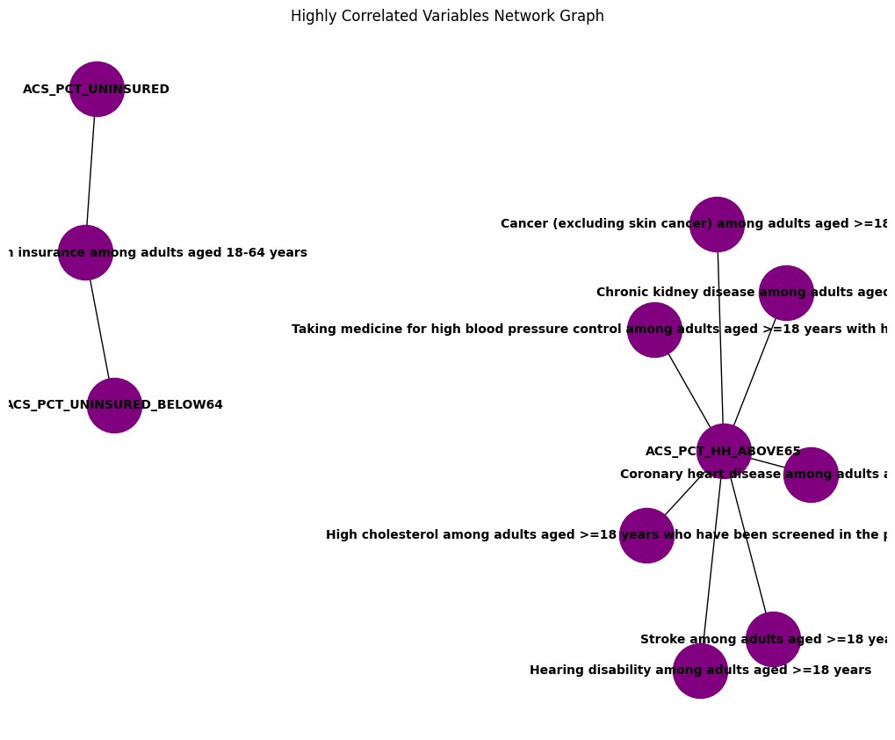
EXPLORATORY DATA ANALYSIS
HIGHLY CORRELATED VARIABLES NETWORK GRAPH:
The arrangement of nodes in clusters can reveal subsets of highly interrelated variables, indicating potential underlying phenomena or processes. Nodes with extensive connectivity may signify variables central to the dataset or strongly related to multiple others.
For instance, ACS_PCT_HH_ABOVE65 (i.e. Percentage of Households with Members Aged 65 and Above) correlates strongly with health outcomes like cancer, high cholesterol, high blood pressure, stroke and chronic kidney disease among adults aged 18 years and above in the mental risk context within cluster 2.

Slide 7
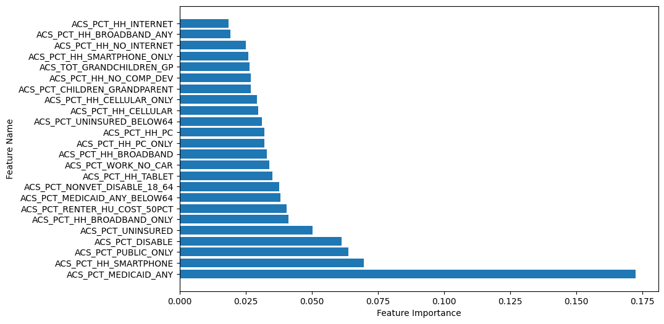
EXPLORATORY DATA ANALYSIS
FEATURE IMPORTANCE USING RANDOMFOREST:
The plot showcases the importance of each feature in predicting health risks associated with educational risk. Features with higher importance scores indicate greater significance in determining health outcomes linked to educational risk factors.
Understanding these influential features can inform targeted interventions aimed at addressing health disparities stemming from educational challenges, potentially leading to improved health outcomes and well-being among at-risk populations.

Slide 8
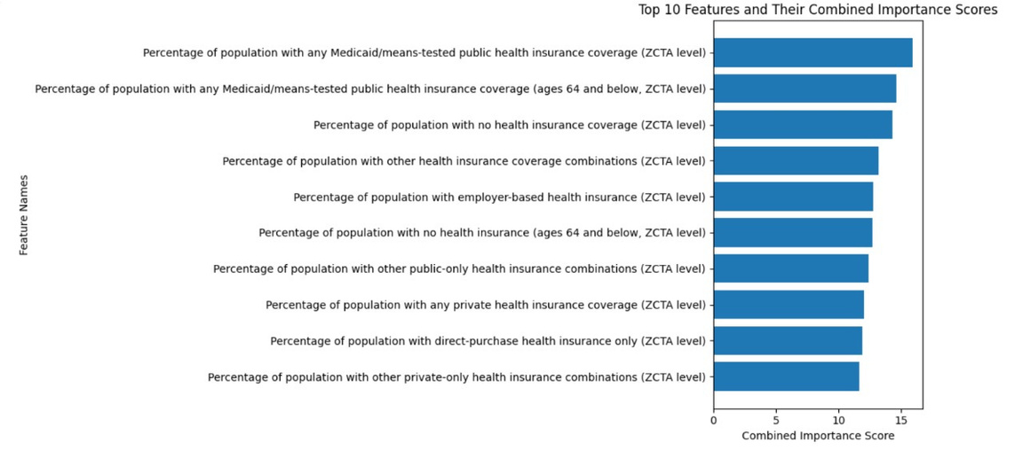
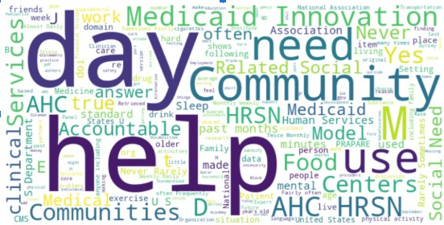
OBJECTIVE 1
ANALYSIS OF STANDARDISED SURVEYS USING NLP
IMPORTANCE OF FEATURES BASED ON QUESTIONNAIRES
Created a word cloud to visualize the most prevalent risk categories identified from three standardized PDF questionnaires. The size of each word reflects its frequency in the questions, offering insight into the most common risks.
Extracted key terms from the questionnaires, calculated cosine similarity between each feature name and these terms, and mapped the feature names with their importance scores. Then, I sorted the feature names based on their scores.

Slide 9

OBJECTIVE - 1

Slide 10
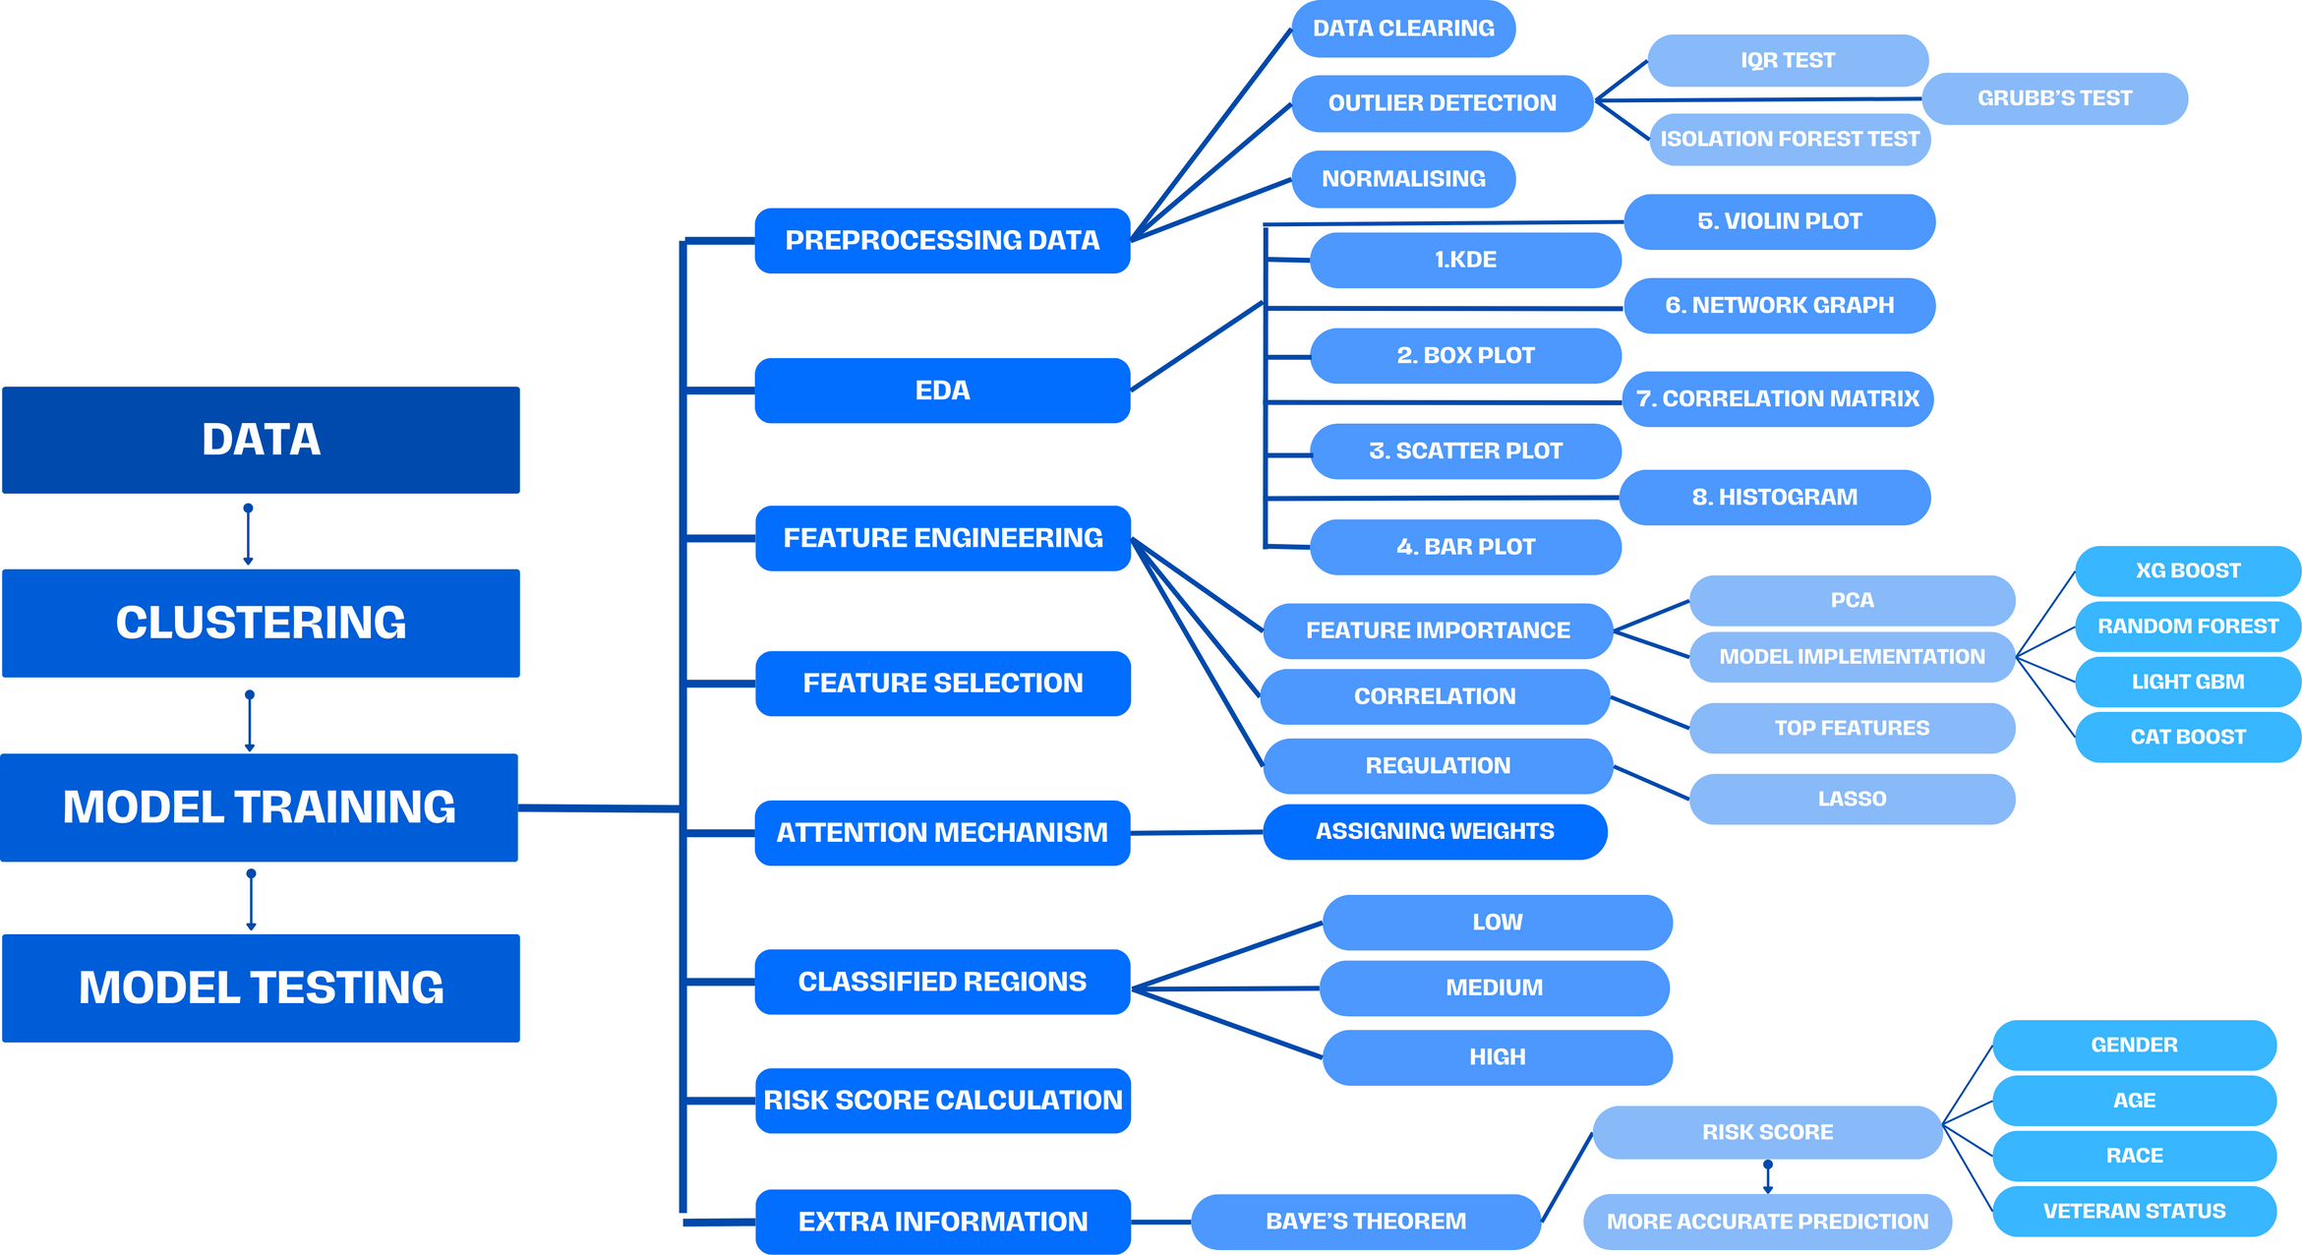
OBJECTIVE 1
MODEL APPROACH

Slide 11
OBJECTIVE 1
PREDICTIVE MODEL DEVELOPMENT
FEATURE SELECTION FROM RAW DATA
INDICATOR LABELLING FOR RISK ASSESSMENT
01
03
05
DATA COLLECTION AND PREPROCESSING
MAPPING ZIP CODES WITH CENSUS TRACT DATASET
02
OUTLIER ANALYSIS
04
CLUSTERING USING K-MEANS ALGORITHM

Slide 12
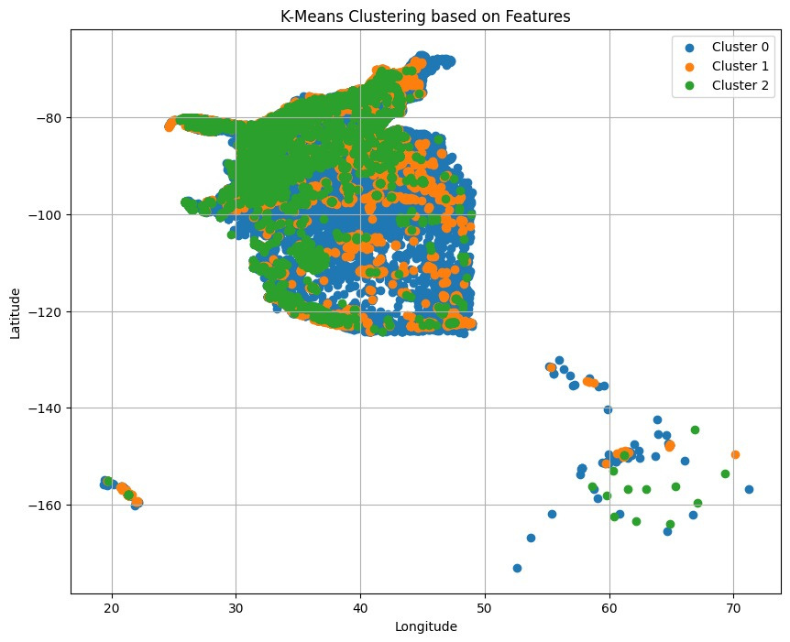
OBJECTIVE 1
CLUSTERING USING K-MEANS ALGORITHM
K-Means Clustering in Data Preprocessing
It entails organizing ZIP codes into clusters based on the similarity score of their features. Once these clusters are established, models are trained individually on each cluster.

Slide 13
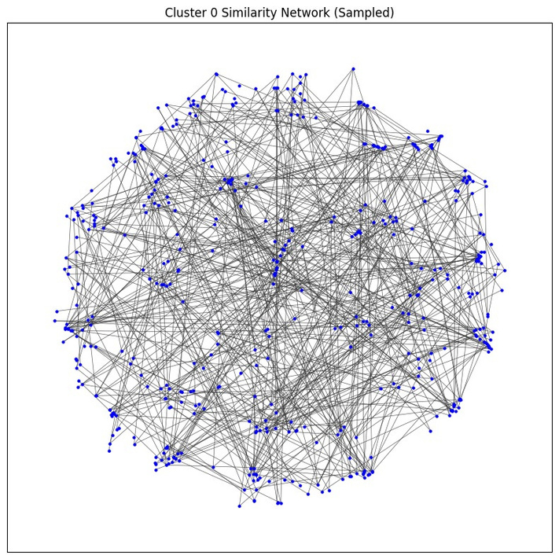
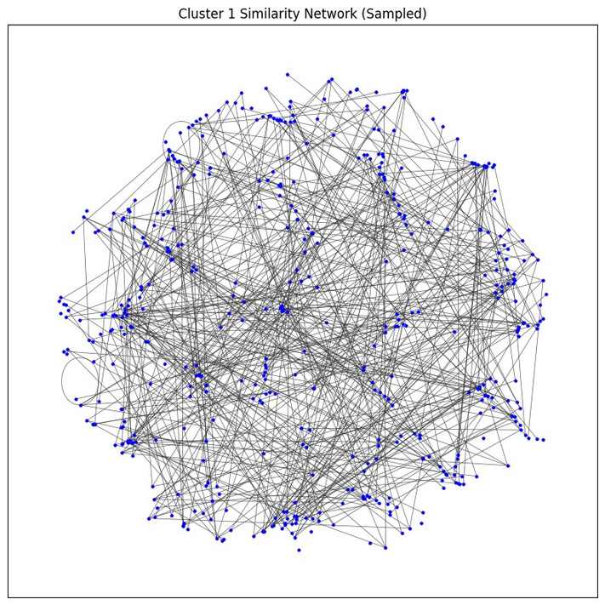
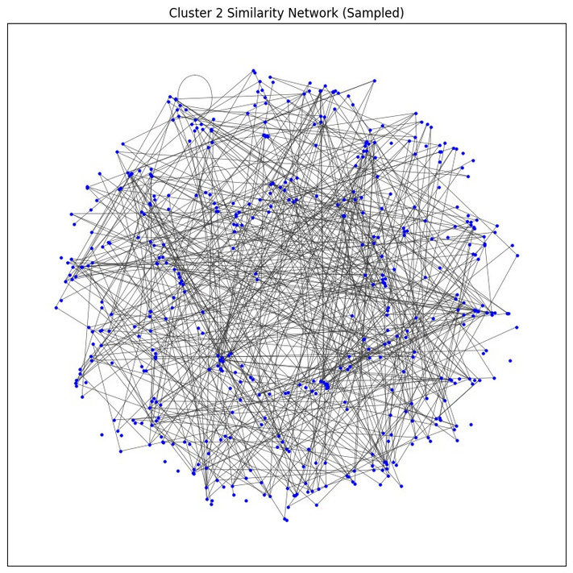
OBJECTIVE 1
NETWORK GRAPH CLUSTER
In this network graph cluster plot, each node represents a zip code within a specific cluster. The connections between nodes depict the cosine similarity between the features associated with each zip code.
These connections illustrate the degree of similarity in the feature profiles of different zip codes within the same cluster.
By visualizing these relationships, we gain insights into the underlying patterns and similarities in the dataset, aiding in the understanding of geographic clusters with similar characteristics and potential correlations between various features.

Slide 14








OBJECTIVE 1
MODEL SELECTION AND TRAINING
METHODOLOGY : USING CONCEPT OF ATTENTION MECHANISM
FEATURE IMPORTANCE ANALYSIS
WEIGHT ASSIGNMENT TO RISK INDICATORS
RISK SCORE CALCULATION
RISK LEVEL ASSIGNMENT
Conducted feature importance analysis to determine the significance of each variable in influencing health outcomes by training XGBoost, LightGBM, Random Forest, and CatBoost models with risk indicators as input features and health outcomes as targets.
Assigned weights to each risk indicator based on its positive or negative correlation with health outcomes. This step enabled us to capture the varying degrees of impact that different risk factors exerted on individual health outcomes.
Utilizing the assigned weights derived from feature importance analysis, we performed a weighted summation for each census track ID, thereby generating a comprehensive risk assessment
Normalized computed risk scores were used for consistency across indicators and locations, followed by K-Means Clustering to categorize them into low, medium, and high-risk segments based on established thresholds.

Slide 15
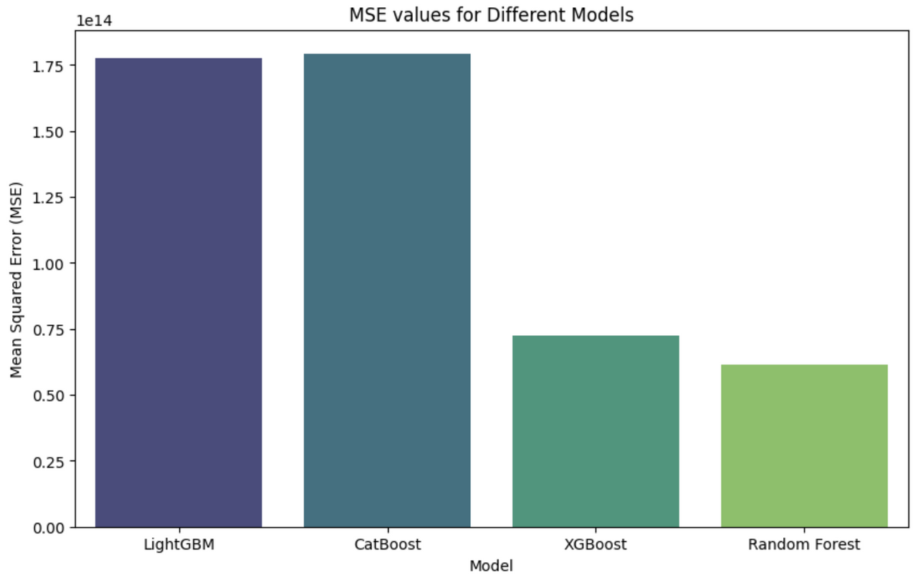
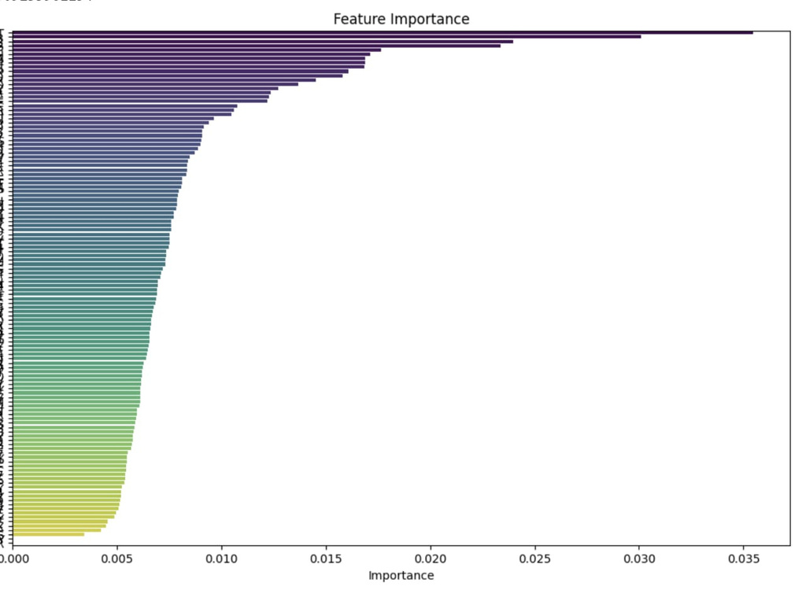
OBJECTIVE 1
MODEL SELECTION AND TRAINING
FEATURE IMPORTANCE AND ANALYSIS
AMONG ALL THE MACHINE LEARNING MODELS RANDOM FOREST REGRESSION GIVES THE BEST RESULT WITH LEAST MEAN SQUARED ERROR
ESTIMATION OF IMPORTANT FEATURES WITH THEIR WEIGHTS BY RUNNING XGBOOST (TAKING HEALTH OUTCOMES AS TARGET VARIABLES)

Slide 16
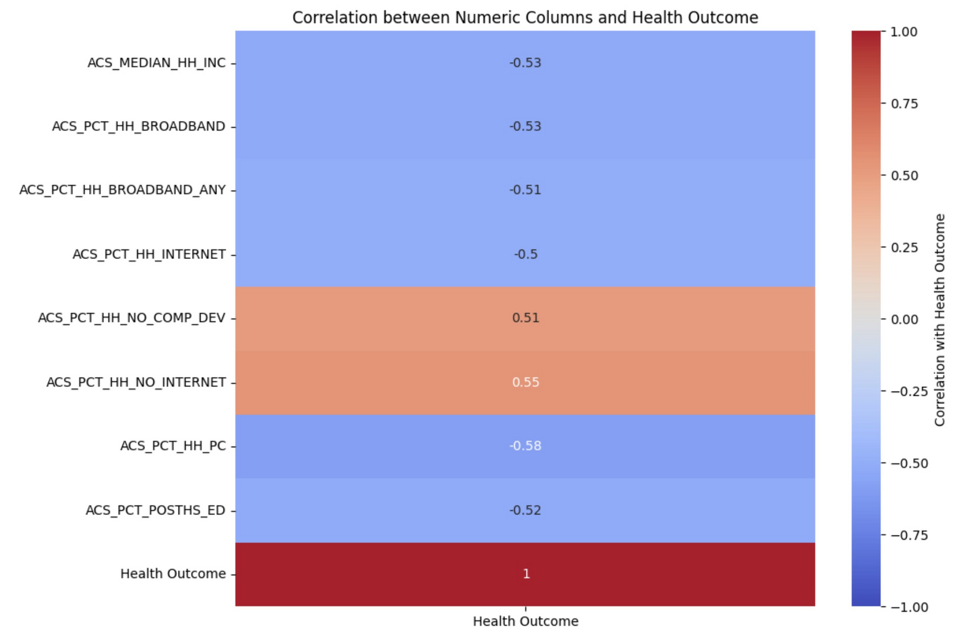
OBJECTIVE 1
MODEL SELECTION AND TRAINING
CORRELATION MATRIX
WEIGHT ASSIGNMENT FOR RISK INDICATORS
We assigned weights to each risk indicator based on its positive or negative correlation with health outcomes.
This step enabled us to capture the varying degrees of impact that different risk factors exerted on individual health outcomes.

Slide 17
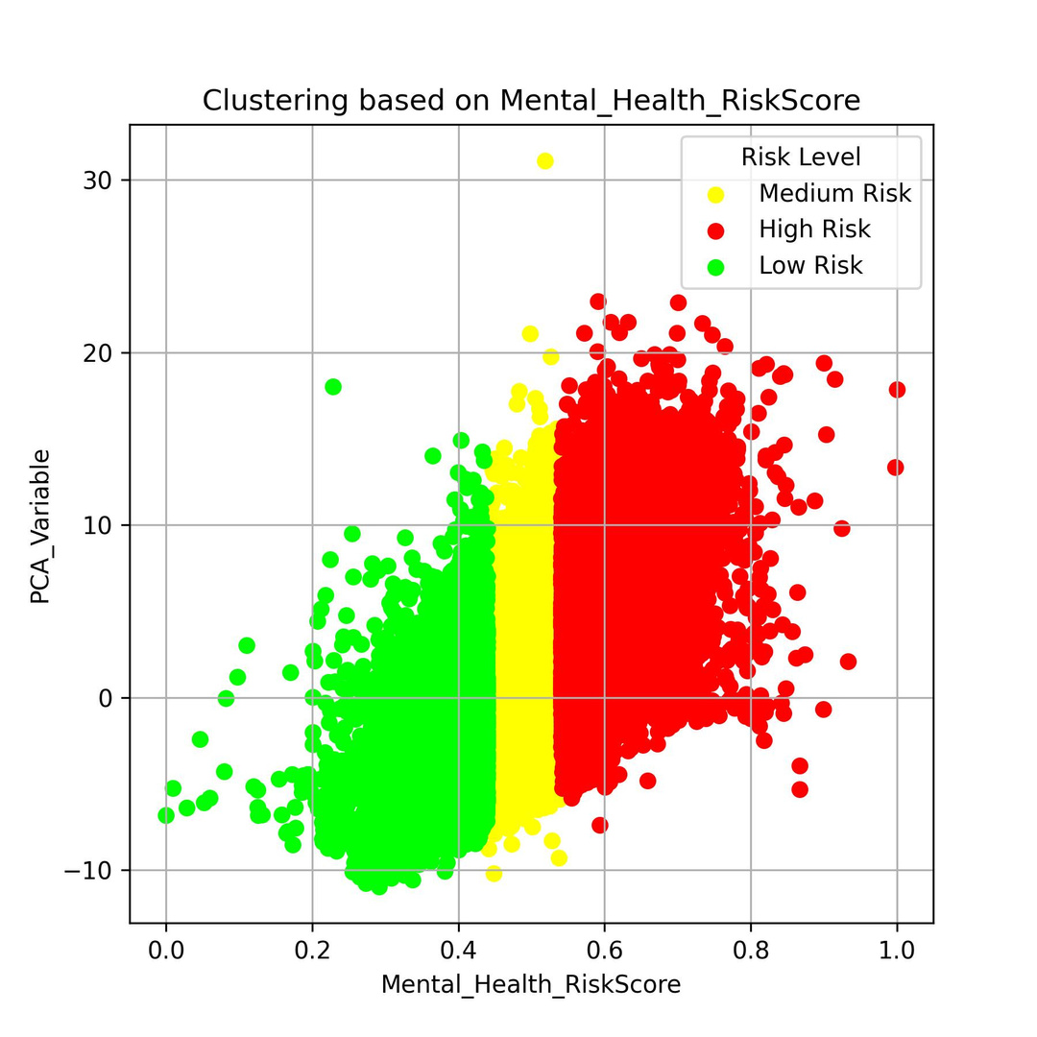
OBJECTIVE 1
MODEL SELECTION AND TRAINING
RISK SCORE CALCULATION AND RISK LEVEL ASSIGNMENT
Weighted sum for each census track ID to calculate risk scores.
Normalized risk scores for consistency across indicators and track IDs.
Used K-Means Clustering to group normalized scores into low, medium, and high-risk.
Set thresholds to classify risk levels for each type of risk within track IDs.
Determined population into low, medium, and high-risk categories based on thresholds.

Slide 18
OBJECTIVE 1
MODEL TESTING
METHODOLOGY : USING CONCEPT OF ATTENTION MECHANISM
PREDICTION OF FEATURE VALUES FOR THE GIVEN ZIP CODE
CALCULATION OF RISK SCORES AND RISK SEGMENTS
STEP 1
STEP 2
STEP 3
STEP 4
CLUSTER ASSIGNNMENT BASED ON SIMILARITY
ADAPTING TO NEW INFORMATION:
REFINEMENT OF SCORES

Slide 19
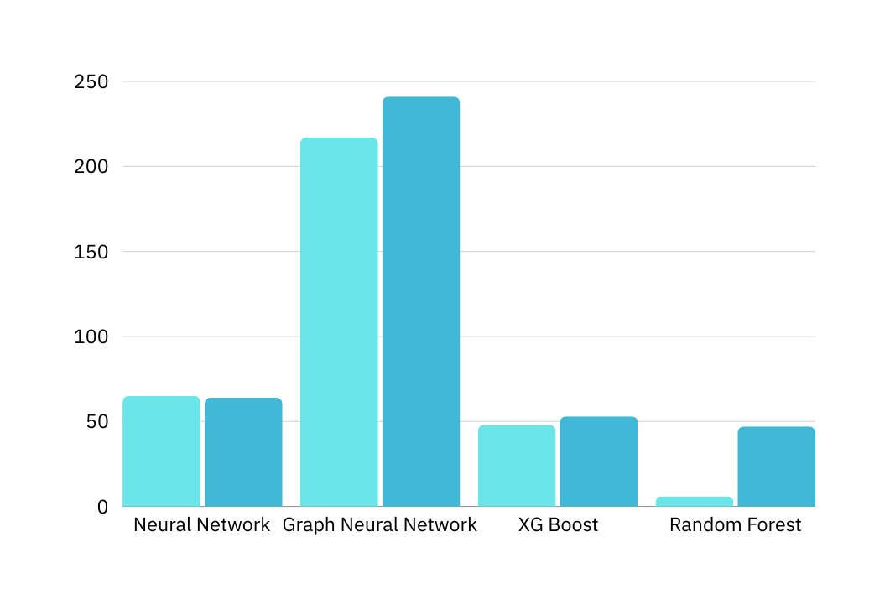
OBJECTIVE 1
MODEL TESTING
PREDICTION OF FEATURE VALUES USING ML AND DL MODELS
Models | Training MSE | Testing MSE
Neural Network | 0.0065 | 0.0064
Graph Neural Network | 0.02175 | 0.024156
XGBoost | 0.00489 | 0.0053
Random Forest | 0.0006667 | 0.0047803
Although the Random Forest model exhibits the lowest MSE on both training and testing data, its significant disparity suggests potential overfitting. Therefore, we've opted for XGBoost as the preferred model for predicting risk scores.

Slide 20

OBJECTIVE 1
MODEL TESTING STEP 4
REFINEMENT OF RISK SCORES USING NEW INFORMATION
QUALITATIVE
QUANTITATIVE
Update risk scores based on additional information, such as gender.
Assumption:Proportional Risk Distribution
it assumes that risk is proportionally distributed across genders within a region, which may not always be accurate.
Example: Calculate risk scores for specific demographics, like older women, by analyzing their indicators and comparing them with corresponding health outcomes.
For instance, the risk score for older women equals the overall risk score multiplied by the proportion of older women in the population.
Limitation: Lack of comprehensive indicators may constrain the accuracy of risk score refinement.
Limitations: Accuracy Concerns: This method may not accurately reflect the distribution of risk across genders within a region.

Slide 21
OBJECTIVE - 2

Slide 22
OBJECTIVE 2
MODEL APPROACH
DATA SCRAPING
DATA PREPERATION
CONSTRUCT NETWORK GRAPH REPRESENTATION
EACH ZIPCODE AS
NODE
DEFINE EDGES BETWEEN
NODES BASED ON SIMILARITY
RISK SCORE CALCULATION (REGION WISE)
EACH RISK HAS MAXIMUM 3 SUGGESTIONS
10 TYPES OF RISKS
RECOMMENDATIONS SCORE CARD
ASSIGN EACH SUPPORT DATA BASE TO SPECIFIC RISK CATEGORY
GENERALISED SUGGESTIONS FOR EACH HIGH AND MEDIUM RISK INDICATORS
GEOGRAPHICAL PROXIMITY OF EACH ZIPCODE TO RELEVANT SERVICES/FACILITIES
CUSTOMISED DATA BASE

Slide 23
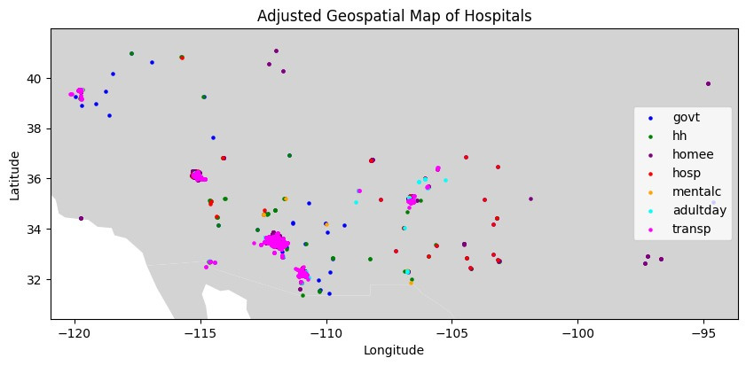
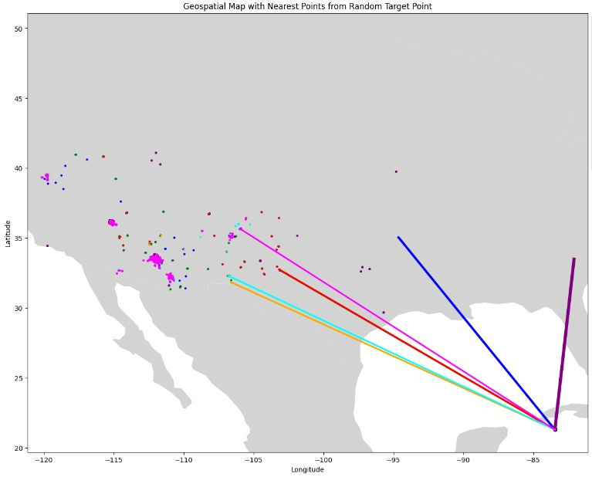
OBJECTIVE 2
ACTION-BASED IMPLEMENTATION
GENERATED GEOSPATIAL MAPS DISPLAYING HOSPITAL LOCATIONS AND CREATED A SECONDARY MAP HIGHLIGHTING NEAREST HOSPITALS TO A RANDOMLY SELECTED TARGET POINT (ZIP CODE), FACILITATING IMPROVED HEALTHCARE NAVIGATION AND RESOURCE UTILIZATION.

Slide 24
OBJECTIVE 2
ACTION-BASED IMPLEMENTATION
IDENTIFY SOCIAL DETERMINANTS & CORRESPONDING RISK
MAPPED EACH DATASET TO THE IDENTIFIED RISK
TRANSPORTATION RISK :
HOME HEALTH CARE
MENTAL RISK:
PSYCHIATRIC HOSPITALS
EMPLOYED GEOCODING API TO EXTRACT THE LATITUDE , LONGITUDE USING ADDRESS
FINANCIAL RISK :
GOVERNMENT HOSPITALS
GENDER HOSPITAL INFORMATION
SUGGESTED THE NEAREST MEDICAL SERVICES
GENERALISED SUGGESTIONS

Slide 25
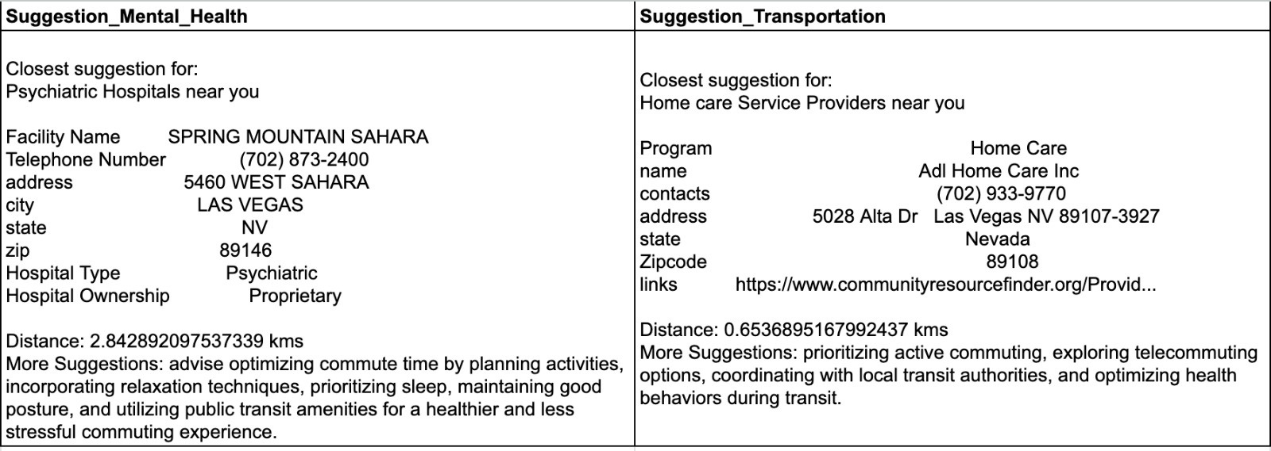
OBJECTIVE 2
SUGGESTION SCORECARD VISUALISATION

Slide 26
OBJECTIVE - 3

Slide 27
OBJECTIVE 3
COMPARATIVE ANALYSIS
INDIA
USA
PROBLEM
DIFFICULTY IN DATA COLLECTION
LESS LITERATE PEOPLE IN INDIA
MORE JOB INSECURITY IN INDIA
POOR STANDARD OF LIVING IN INDIA
POOR MEDICAL FACILITIES IN INDIA
POOR CARE FACILITIES IN INDIA
POOR ECONOMIC CONDITIONS IN INDIA
POOR HEALTH CARE SYSTEM
481 PER KM SQ
25.439 M USD
77.7%
79%
7.3%
8500 USD
37 PER KM SQ
76,770 USD
3.416 M USD
2.87
0.53
0.73
3.56
3.6%
2390 USD
40 USD
CONCLUSION : MORE CHALLENGES FACED IN THE INDIAN CONTEXT MODEL AS COMPARED TO THE USA MODEL
POPULATION DENSITY
LITERACY
RATE
UMEMPLOYMENT RATE
AVERAGE
INCOME
HOSPITAL BEDS
PER 1000 PEOPLE
PHYSICIANS PER
1000 PEOPLE
GDP
ANNUAL HEALTHCARE EXP PER PERSON

Slide 28
OBJECTIVE 3
OUR PERSPECTIVE IN THE INDIAN CONTEXT
PERSPECTIVE IN INDIAN CONTEXT
DATA COLLECTION
IMPORTANT FEATURES
RISKS
TAKING IT FURTHER
BUILDING HEALTHIER COMMUNITIES
DATA SOURCES
CENSUS TRACK
VOTING DATA
FOOD DELIVERY APPS
OPEN GOVERNMENT DATA (OGD) PLATFORM INDIA
INDIASTATE
NSSO EMPLOYMENT SURVEY
NFHS
DLHS
GENDER
AREA-RURAL/URBAN
AGE
EDUCATION
RELIGION/CASTE/TRIBE
SOCIAL ISSUE(CHILD MARRIAGES, CULTURAL PRACTICES
ABORTION RATES
EMPLOYMENT
MARITAL STATUS
NO. OF FAMILY MEMBERS
REGIONAL HERIDITY HISTORY
TRANSPORTATION
INCOME AND SOCIAL PROTECTION
HOUSEHOLD CONDITIONS
FOOD HABITS
EARLY CHILDHOOD DEVELOPMENT
CLIMATE
BMI(<18 , 18-25, >25)
TRANSPORTATION
NUTRITION
FINANCIAL
HOUSING
LANGUAGE BARRIER
DISCRIMINATION BARRIER
EDUCATIONAL
TECHNICAL
LEGAL
ENVIRONMENTAL
FAMILY CONFLICTS
SELF-CARE
MENTAL HEALTH
SOCIAL
COMFORTING CARE
PREVENTIVE CARE
SUPPORT
TECHNICAL
PLANNING
PARTNERSHIPS
RESOURCE ALLOCATION
CULTURAL SENSITIVITY
GENDER SENSITIVITY
LANGUAGE PREFERENCE
EARLY INTERVENTION
SANITATIONAL AWARENESS
ECONOMIC
INFORMATIONAL
EMOTIONAL
EHR
(ELECTRONIC
HEALTH REPORTS)
INFRASTRUCTURAL
SCHOOLS
OLD AGE HOMES
HOSPITALS
SANITATION
NGOS
AWARENESS
SELF-CARE
SANITATION
HEALTH
TRANSPORTATION
ROAD DEVELOPMENT
TRANSPORT FACILITIES
POLLUTION
GOVERNMENT
GOVERNMENT POLICIES
TARGETED INTERVENTION
VACCINATION
DRIVES
NUTRITION

Slide 29
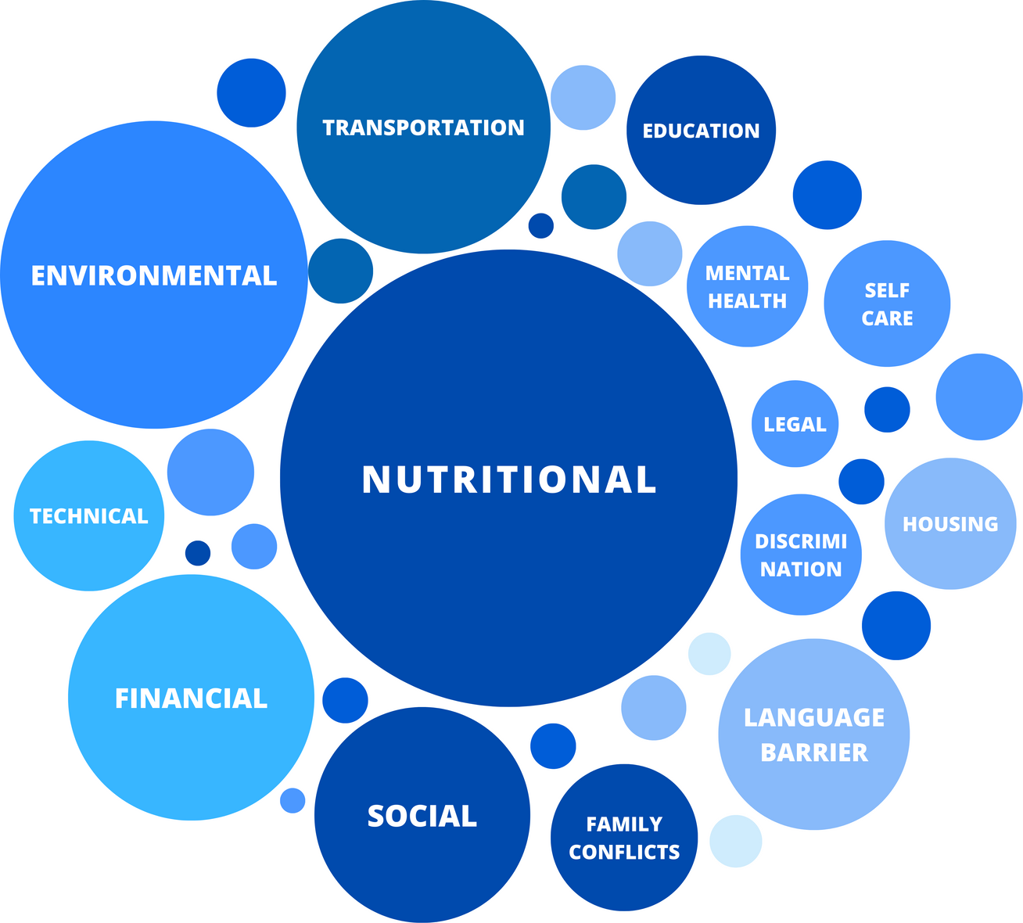
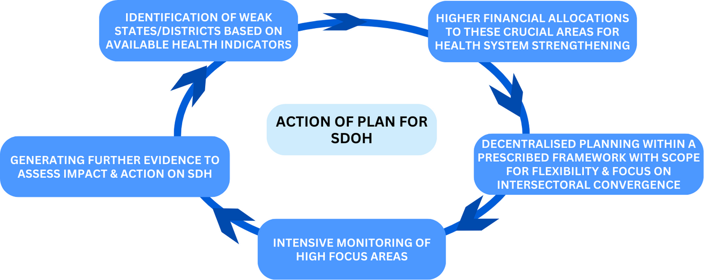
OBJECTIVE 3
PLAN OF ACTION IN THE INDIAN CONTEXT
Plan of action for SDOH which can be implemented in India
Visual Representation of risks in India according to the research done

Slide 30


THANK YOU

